Slide 1
Ajax
JavaScript

Slide 2
What is Ajax?
Ajax (formerly AJAX—Asynchronous JavaScript And XML) occurs when JavaScript is used to make web requests in addition to the original web page load(s).
When introduced as a viable concept and popularized throughout the web, JavaScript’s XMLHttpRequest function was used for this purpose.
Since then, however, alternatives have presented themselves. The most widely adopted one is the fetch function.
When you’re on the Facebook website and viewing your Newsfeed, notice that it starts out showing a set number. If you want to see more updates, you must scroll to the bottom of the feed and it adds them to the webpage in real-time.
Ajax is what makes this possible—your browser (via JavaScript) is loading each of those new posts only as the webpage needs them.
The logic there would be something like: wait for the user to scroll down; if the user hits the bottom ask a Facebook endpoint for more post data; add elements to the page for the data.

Slide 3
The JavaScript fetch Function
In JavaScript we can use fetch to make requests to web servers. It’s syntax is much easier and shorter to write than the traditional HttpXMLRequest way of doing things, but does involve promises.
There are two arguments that you should be aware of when using fetch:
URL (string)
Options (object)
For basic requests, just passing in just a URL may be enough to get the desired response.
You can get quite in-depth with how you set up and handle the initial request, as well as the data you receive.
Most simple fetches end up looking something like…
fetch( “http://example.com/endpoint” ) .then( response => response.json() ) .then( data => console.log( data ) ) .catch( error => console.error( error ) );
If the data received is a JSON string, we run the .json() method (see above) on it to convert it into a regular JS object we can more easily work with.

Slide 4
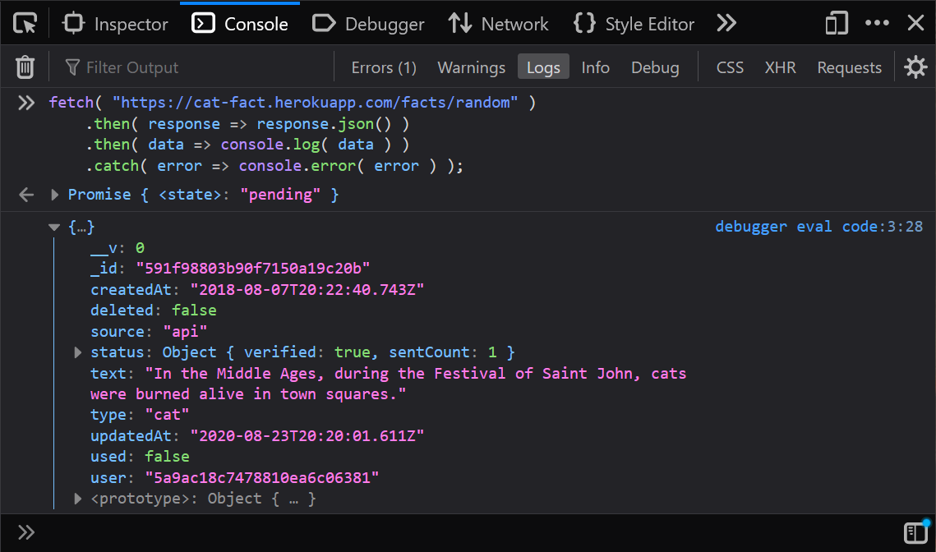
Fetching a Random Cat Fact
Pass, as an argument, the following into the fetch function: https://cat-fact.herokuapp.com/facts/random
The .json() step converts the data to a JS object.
Ensure you console log the data so that you’ll see the result in your web console!
Let’s give fetch a try.
Notes:
fetch( "https://cat-fact.herokuapp.com/facts/random" )
.then( response => response.json() )
.then( data => console.log( data ) )
.catch( error => console.error( error ) );

Slide 5
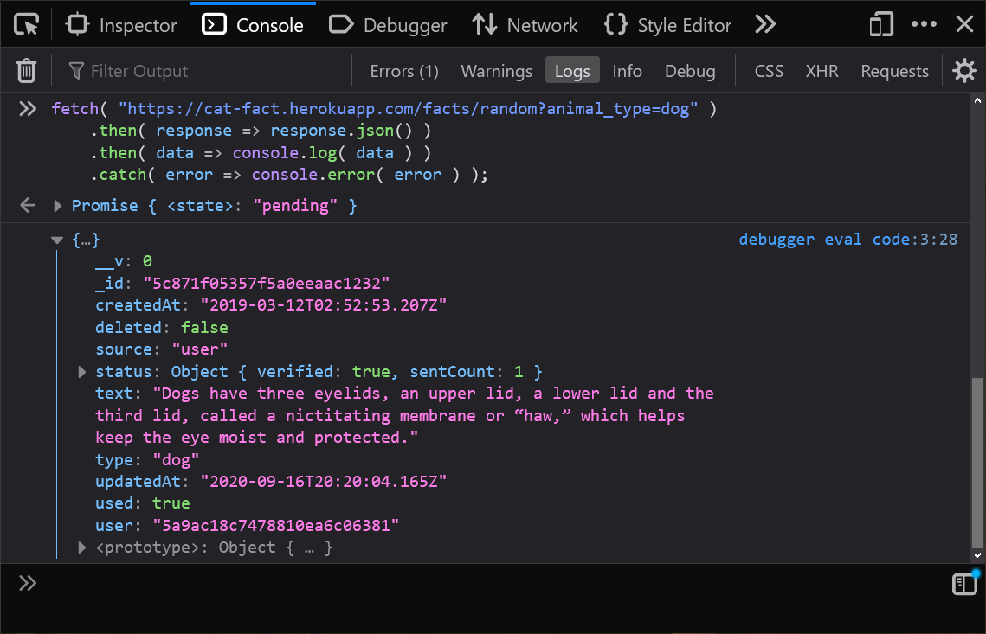
Fetching a Dog Fact
Query string parameters in request URLs can simply be included within the string you pass in…
https://cat-fact.herokuapp.com/facts/random?animal_type=dog
Update the URL to include the animal type.
Notes:
fetch( "https://cat-fact.herokuapp.com/facts/random?animal_type=dog" )
.then( response => response.json() )
.then( data => console.log( data ) )
.catch( error => console.error( error ) );

Slide 6
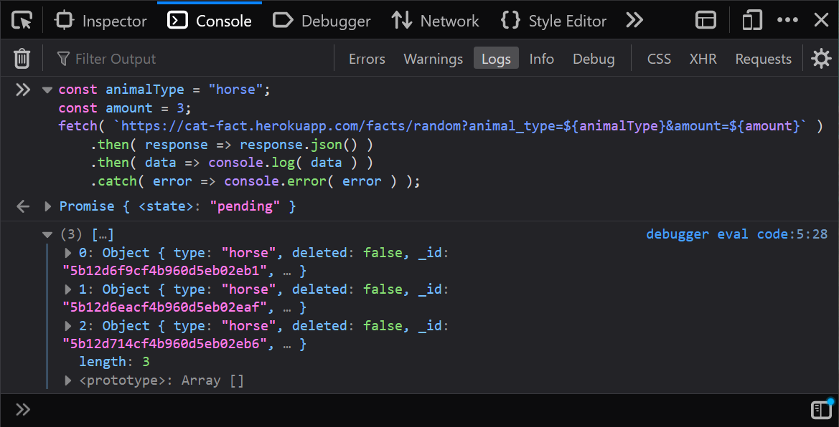
Don’t Forget String Interpolation
Try adding the amount parameter as well, limiting the number of results.
This time, though, we’ll try using a string template literal to include variable values in our string.
Remember to use backticks!
The URL is just a string! You can certainly concatenate or interpolate any values you’d like.
Notes:
const animalType = "horse";
const amount = 3;
fetch( `https://cat-fact.herokuapp.com/facts/random?animal_type=${animalType}&amount=${amount}` )
.then( response => response.json() )
.then( data => console.log( data ) )
.catch( error => console.error( error ) );

